Slide 1
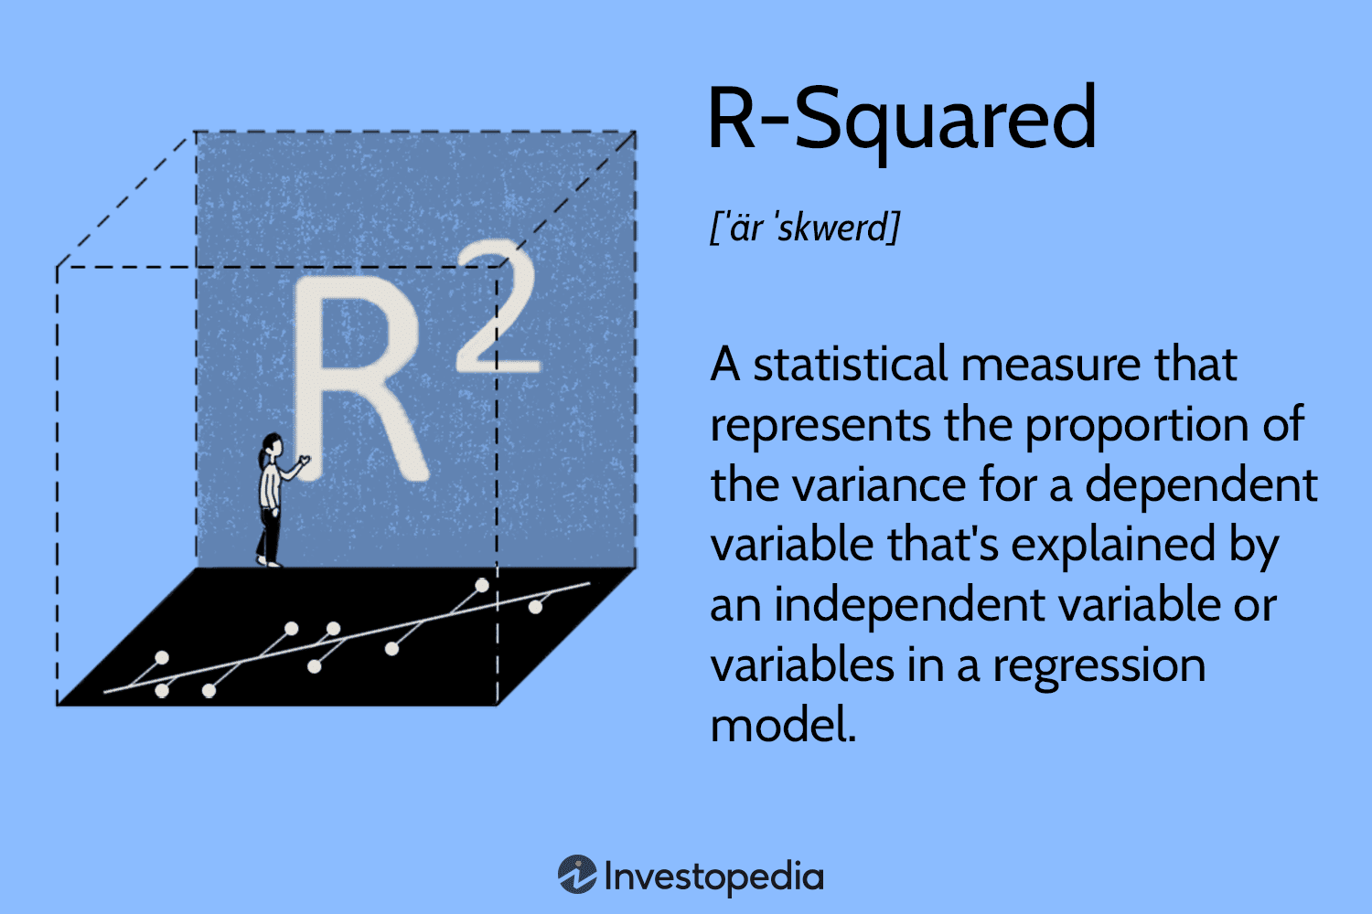
Regression prediction for total Cooking time
Part 2

Slide 2
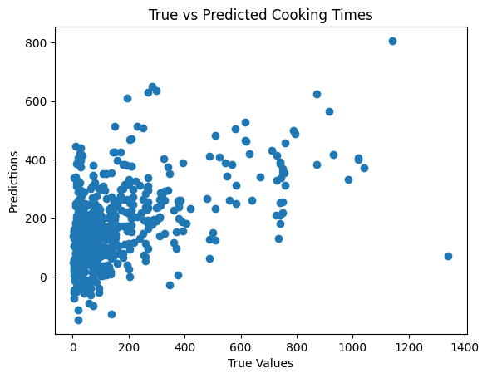
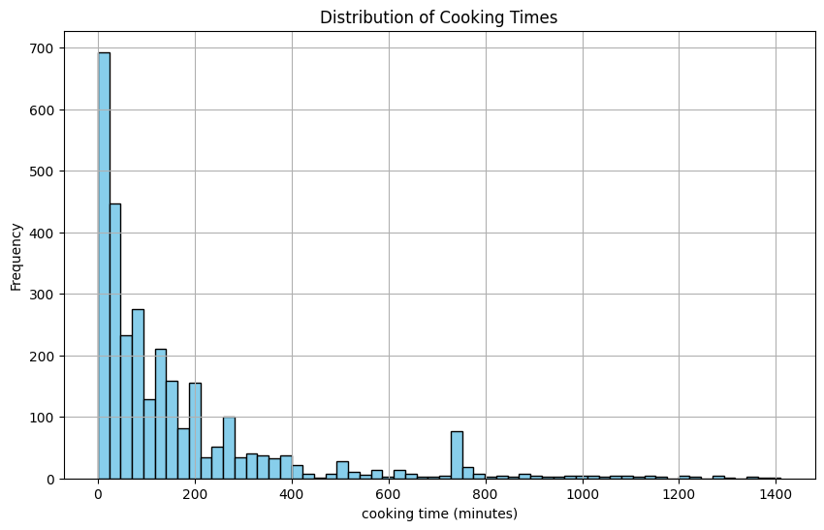
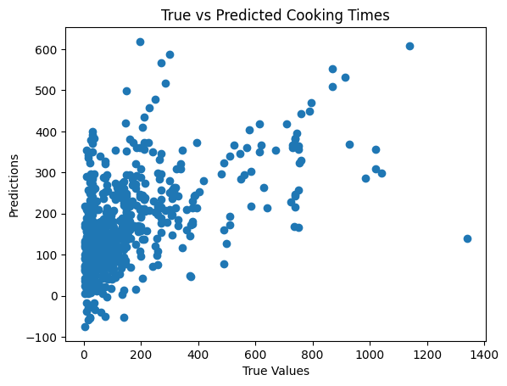
Explorative regression modelling
CLASSIC REGRESSION MODELS
Linear Regression
250 features: R2S.: 0.223
Ridge Regression
10.000 feat.: R2S.: 0.266
Lasso Regression
1.000 feat.: R2S.: 0.25
Elastic Net
10.000 feat.: R2S.: 0.285

Slide 3
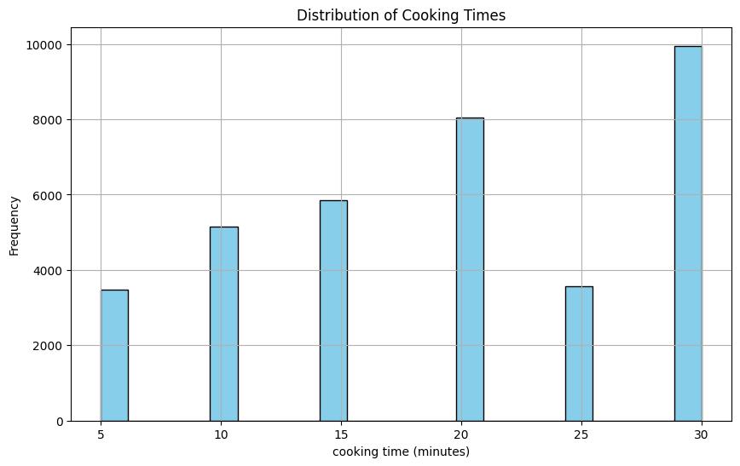
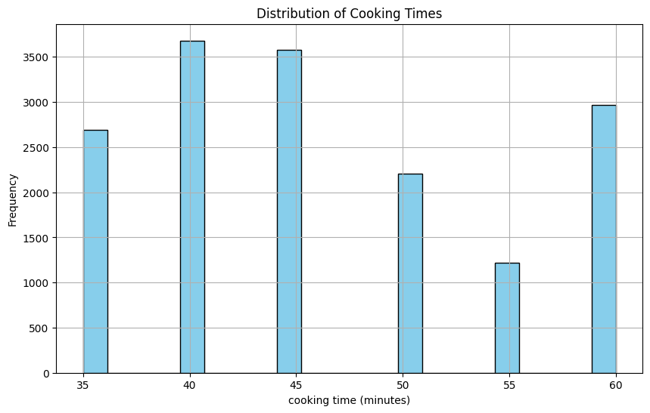
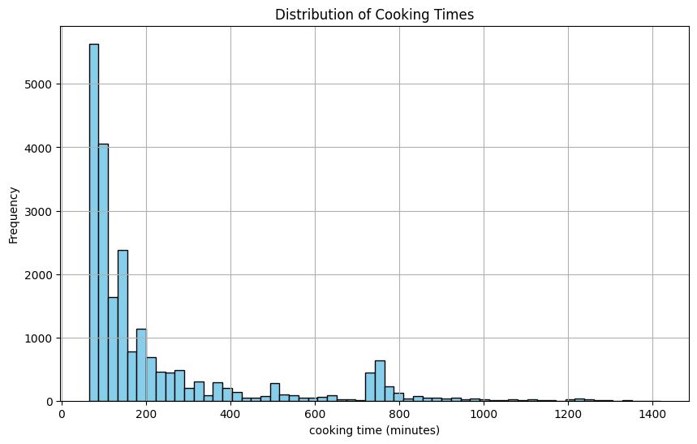
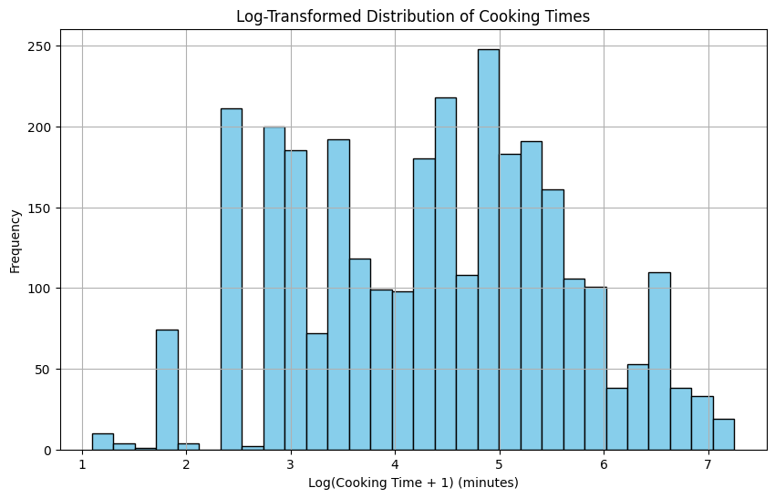
Further Exploration
CLASSIC REGRESSION MODELS
MORE PREPROCESSING
ADVANCED MODELS
Splitting data into different batches
Short: <30 min,
Medium: <60 min,
Long: >60 min
Taking the logarithmic cooking times
Neural net
Easy version of it works
Bert-based-german-cased as base model?
Not working yet

Slide 4
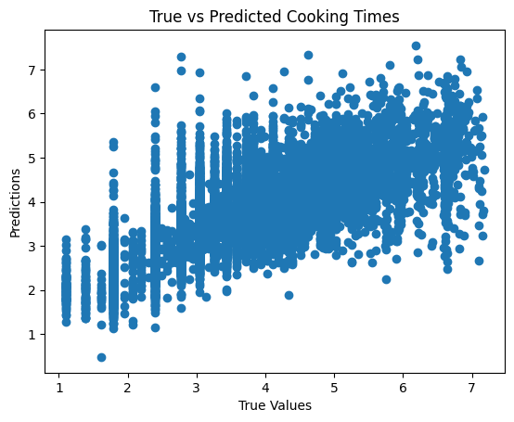
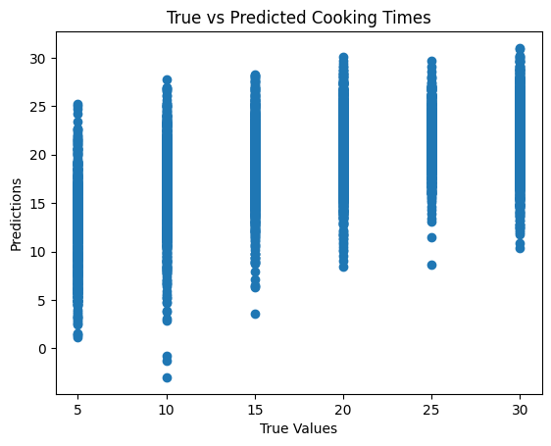
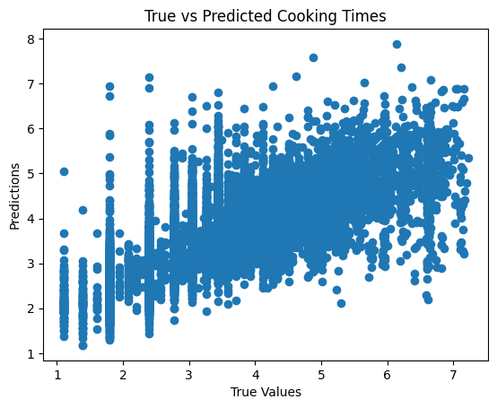
Further Exploration
CLASSIC REGRESSION MODELS
MORE PREPROCESSING
ADVANCED MODELS
E.g. Short: slightly better R2S with conventional models
R2S for short cooking times:
linReg: 0.42
Ridge: 0.44
Lasso:0.35
Elastic Net: 0.4
Even better R2S with logarithmic data
linReg: 0.54
Ridge: 0.54
Lasso:0.52
Elastic Net: 0.53
Neural net
R2S of 0.36
Bert-based-german-cased as base model?
Still Not working

Slide 5
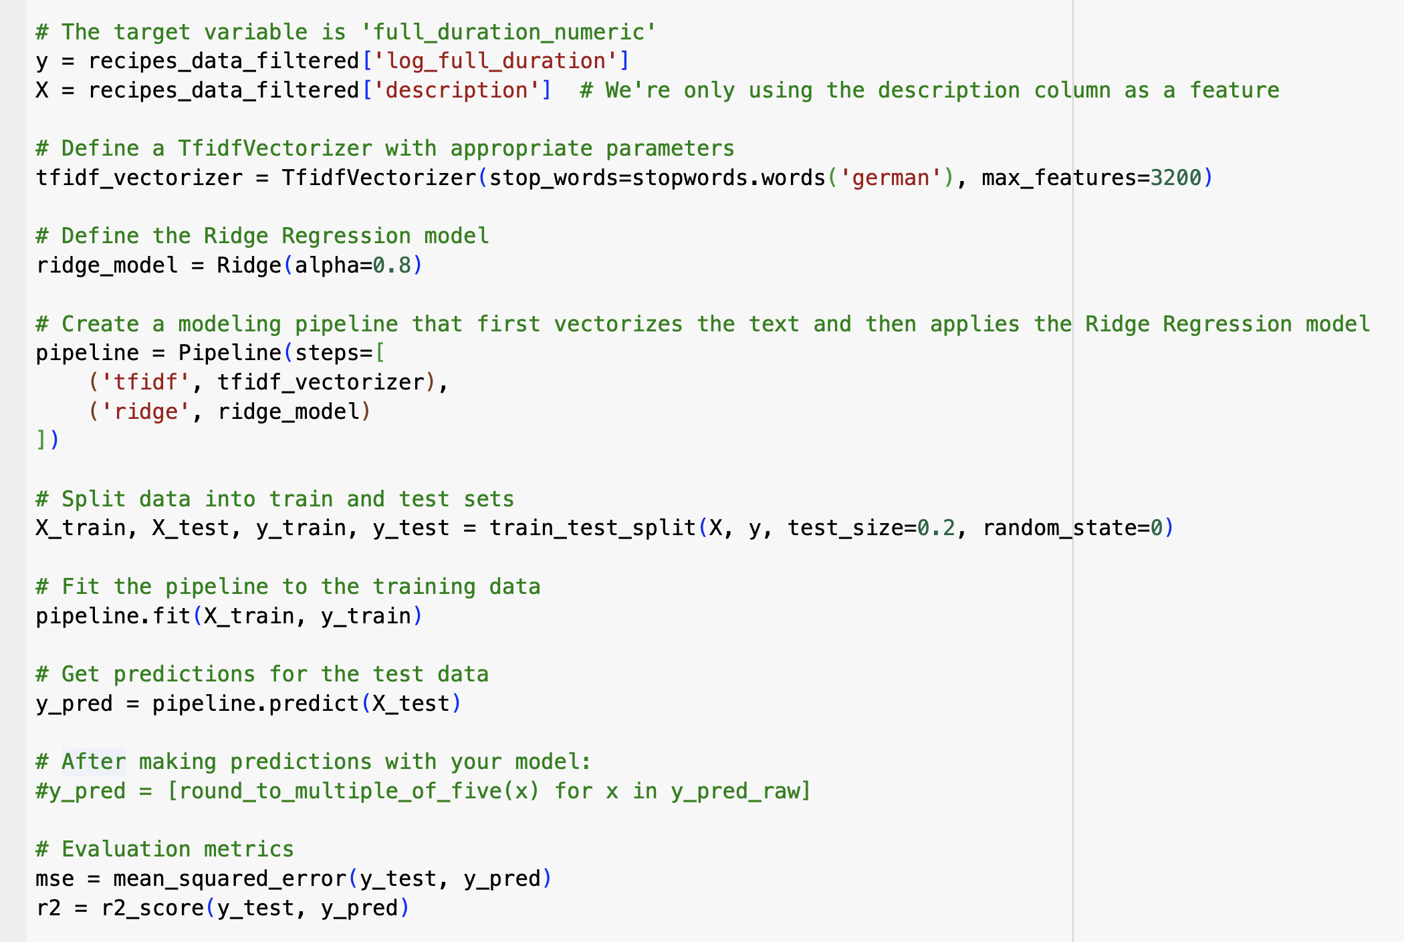
Code from the Ridge Regression on Log Data

Slide 6
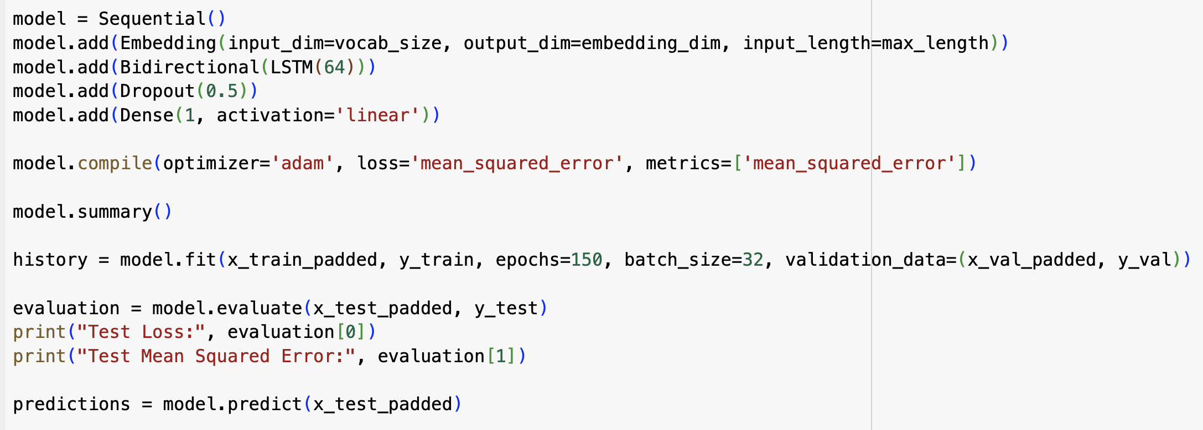
Code from the NN

Slide 7
Next Steps
MORE PREPROCESSING
ADVANCED MODELS
Bring more processed dataframe and best model together
Evaluate more optimization options

